Slide 1
Image-Based Language Translator
(Incredible Bacon Lettuce Tomato)
Group 9:
Chris Drury
Matt Pinsent

Slide 2

The Problem
Unknown languages
Uncommon Phrases
Bad Translations
Don’t know what it says!

Slide 3
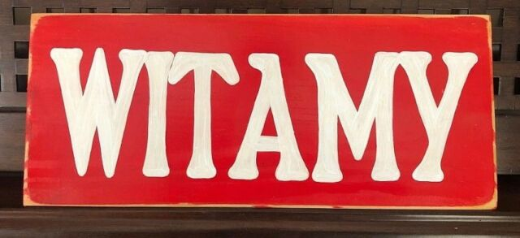
?

Slide 4
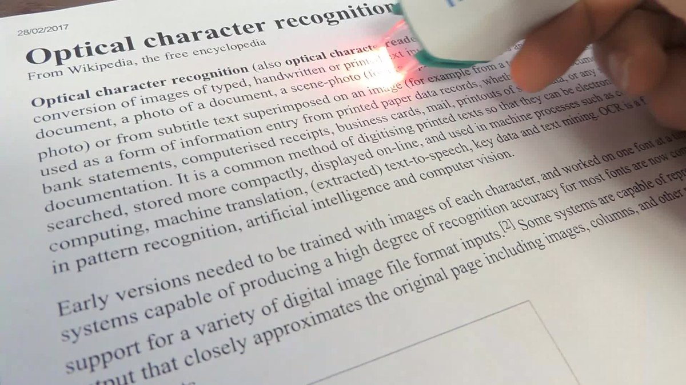
The Solution:
Image-Based Language Translator / IBLT
Pillow
Python image library
Tesseract OCR
Open source Google project
Optical Character Recognition
Pytesseract python wrapper
Googletrans
Google Translate python library

Slide 5

Pillow
Image filtering
Convolution
Gaussian
Drawing
Colour Space Conversions

Slide 6
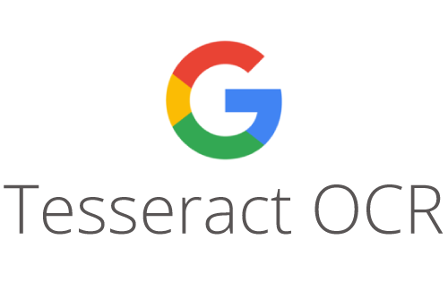
Tesseract OCR
Pytesseract python wrapper
Character Recognition
Line detection
Pattern matching
Trained Neural Network

Slide 7

Googletrans
Google Translate python wrapper
Google Translate Ajax API
Unofficial library
Not always the most correct translation

Slide 8
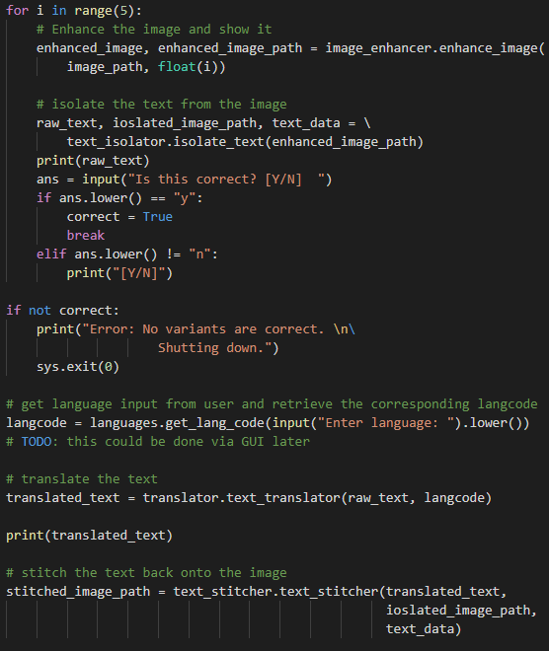
The implementation
Show a little code
6 files
350 lines of code
Trained Tesseract OCR
Interfaced with a CLI
Manual recognition verification

Slide 9
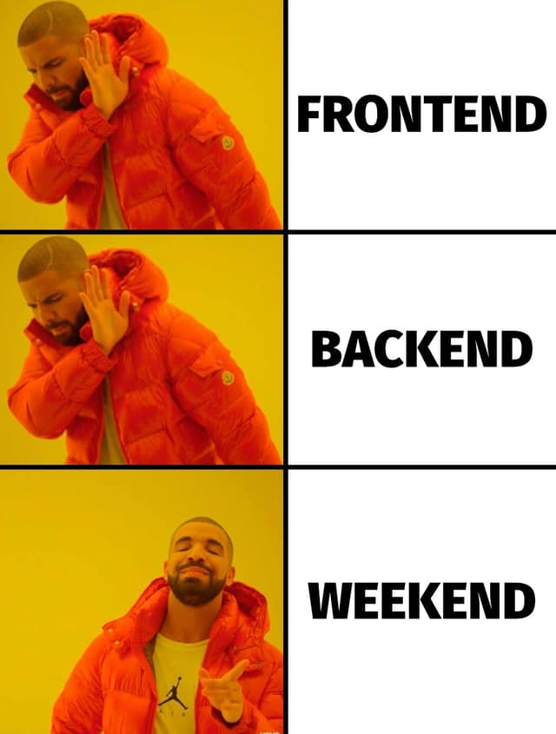
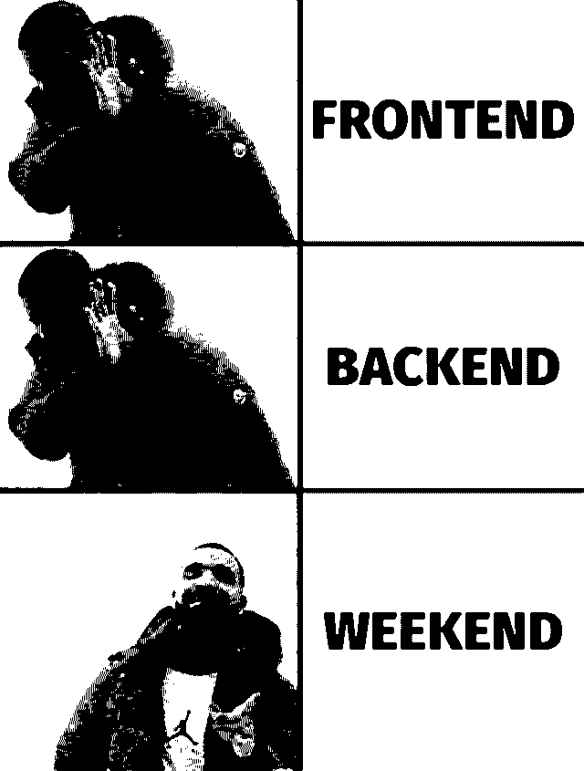
Sharpening -> Gray Scaling -> Filtering

Slide 10

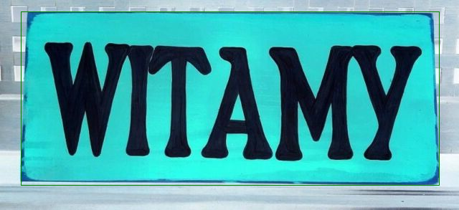
Sharpening -> Inversion

Slide 11

Inversion -> Gray Scaling -> Text Detection

Slide 12
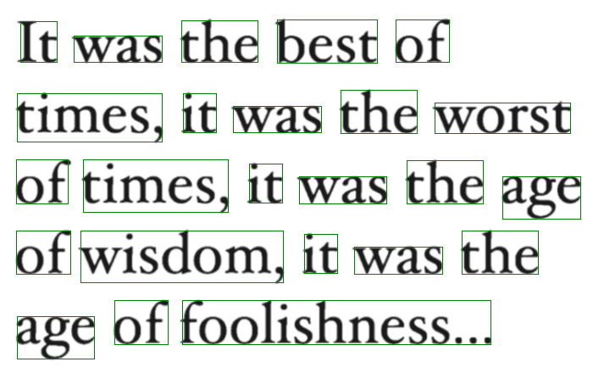
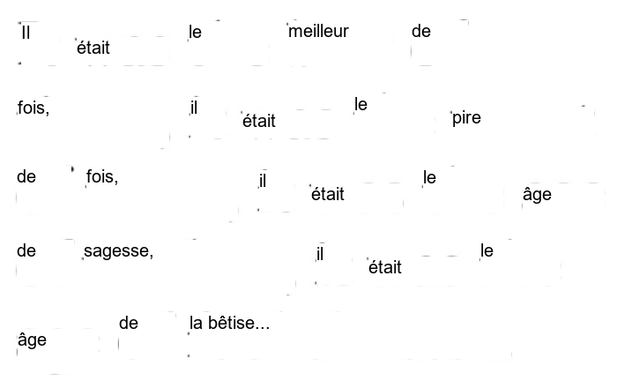
The Final Overlay

Slide 13
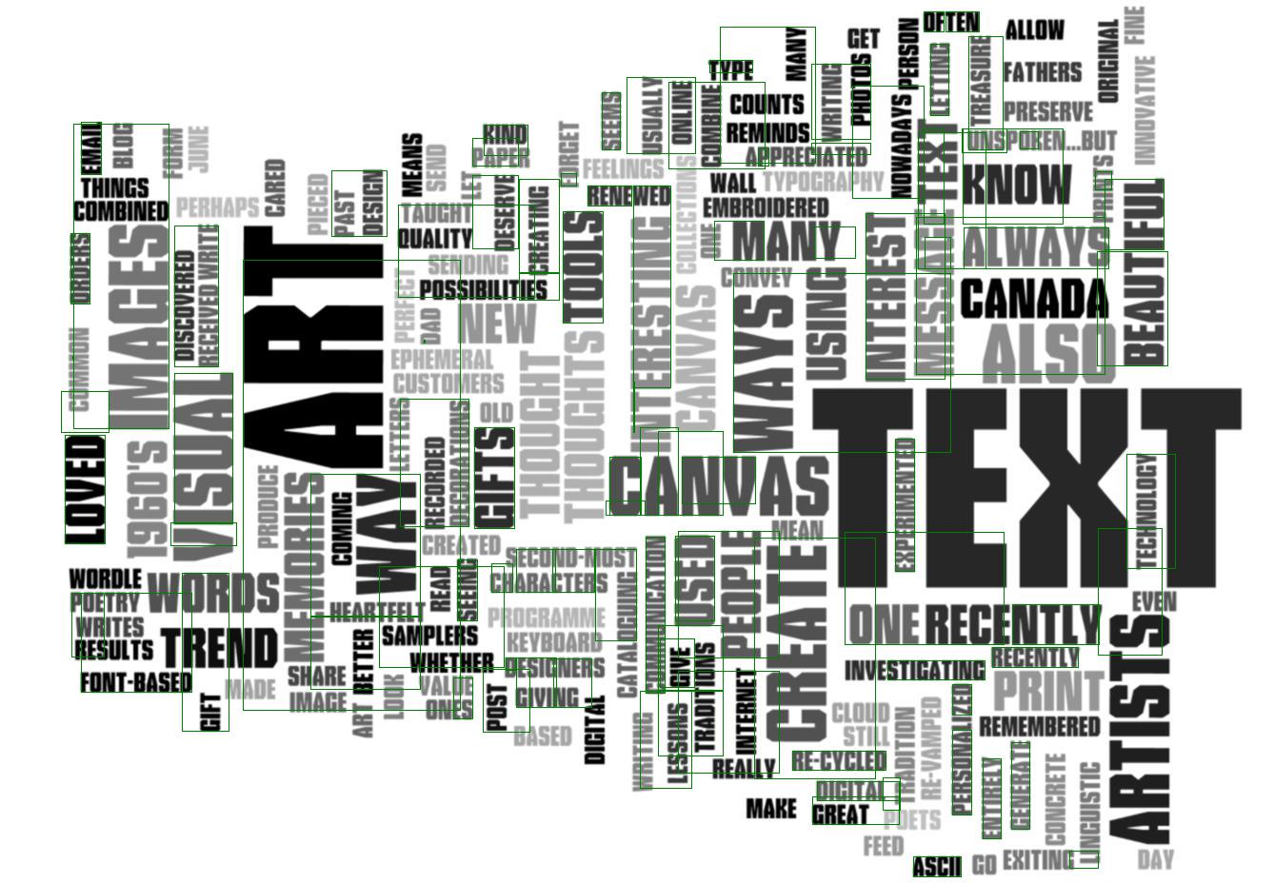

Slide 14
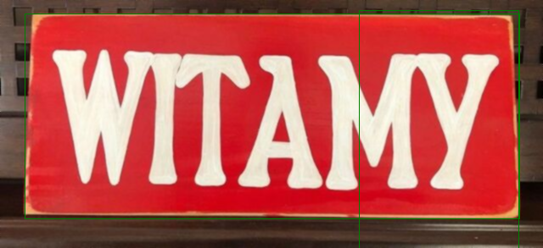
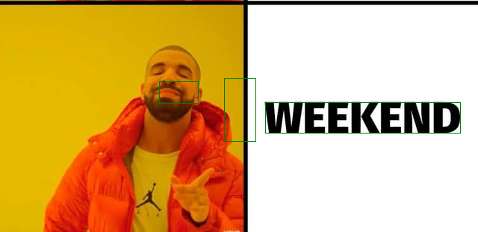
The Accuracy
Different pictures need different 𝞼 values
Within 1 - 5
| ~ ! . characters are incorrectly detected frequently

Slide 15
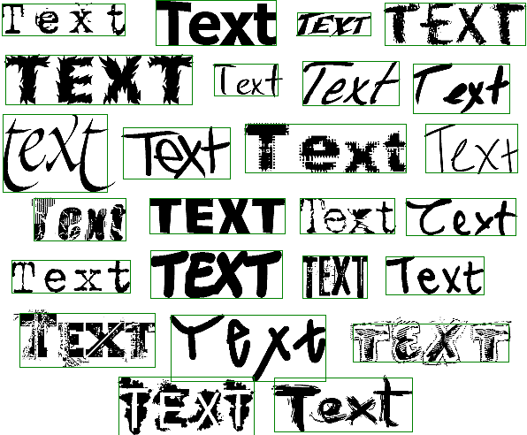
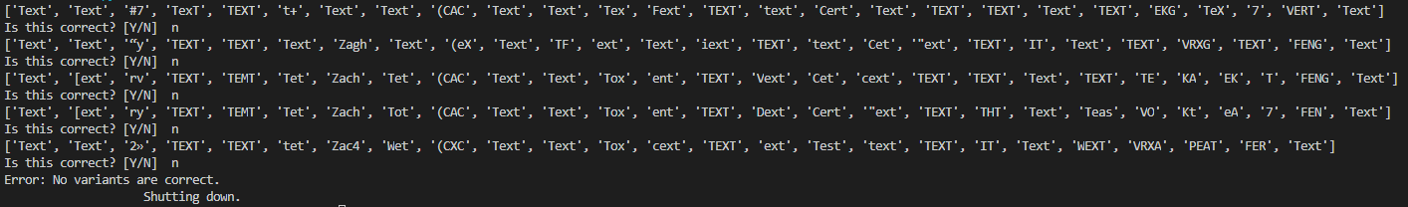

Slide 16
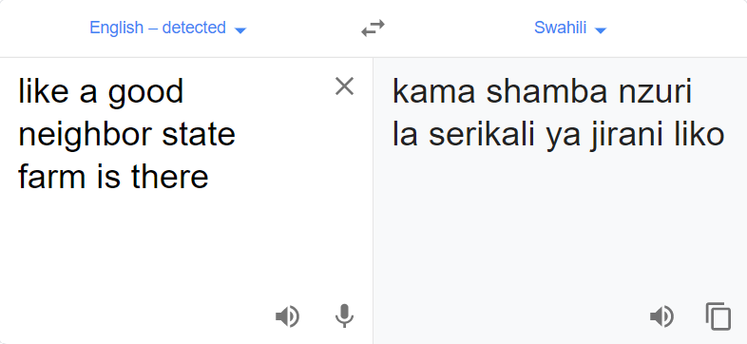
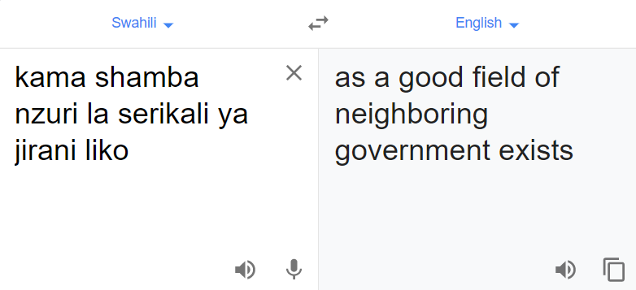
Final conclusion
Limited by API
Real time processing difficult
Google translate
Some fonts recognized better than others
Notes:
realtime translation hard without additional filtering sharpening etc along with manual input
Maybe additional OCR training could allow less need for manual intervention

Slide 17
Questions?

